Slide 1

Project Title: Exploratory Data Analysis of Large‑Scale Industry Performance Dataset
Organization: NextHikes IT Solutions
Authors: by Anshita Srivastava

Slide 2

Exploratory Data Analysis of Large‑Scale Industry Performance Dataset

Slide 3


Slide 4
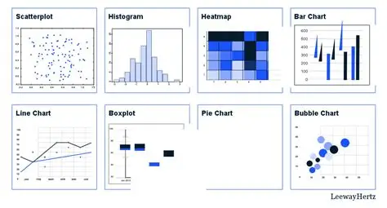
Introduction
Define EDA: Statistical process to explore datasets before modeling
Purpose: Identify trends, relationships, and insights in industry data
Dataset: 15,000 records, 12 variables

Slide 5

Objectives:
Univariate Analysis
Bivariate Analysis
Multivariate Analysis
Outlier Detection
Correlation Study
Skewness & Kurtosis

Slide 6
Univariate Analysis focuses on studying one variable at a time to understand its distribution, average values, and spread. For example, analyzing company revenue alone helps reveal whether most firms earn moderate amounts or if a few generate extremely high revenue.
Bivariate Analysis examines the relationship between two variables, such as employee count and annual revenue. This helps identify whether larger workforces are linked to higher earnings or if customer numbers drive revenue growth.
Multivariate Analysis looks at three or more variables together to uncover complex patterns. For instance, combining industry, revenue, and employee count shows that technology firms with bigger teams often achieve the highest revenues compared to other sectors.

Slide 7
Outlier Detection identifies unusual values that fall far outside the normal range. These outliers, such as extremely high revenues or customer counts, often represent large multinational enterprises and provide important insights into exceptional business scenarios.
Correlation Study measures how strongly two numerical variables move together. For example, annual revenue is strongly correlated with both employee count and customer count, meaning companies with more employees and customers generally earn more.
Skewness and Kurtosis describe the shape of data distributions. Positive skewness indicates that most companies operate at a moderate scale while a few dominate with very high values. High kurtosis highlights the presence of extreme cases, such as very large enterprises, which shape overall industry performance.

Slide 8
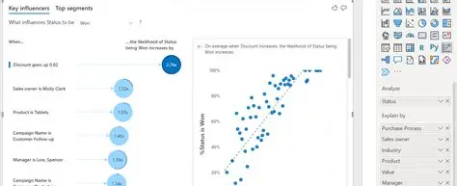
Dataset Overview
Rows: 15,000 | Columns: 12
Data Types: Numerical, Categorical, Date
Features: id, company name, industry, country, employee_count, annual_revenue_million, profit_margin_percent, founded_year, customer_count, market_rating, created_date, region

Slide 9
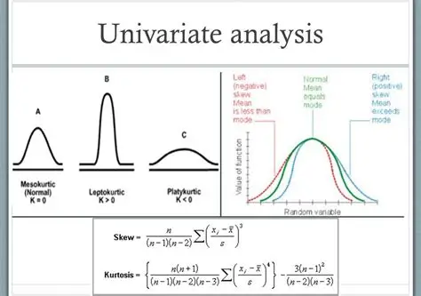
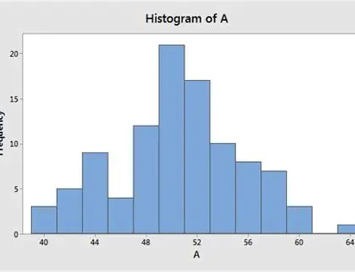
Univariate Analysis
Numerical Variables: Mean, Median, Std Dev, Skewness, Kurtosis
Categorical Variables: Frequency distributions
Example Insights:
Revenue positively skewed
Employee count variance high
Retail sector → large customer bases

Slide 10
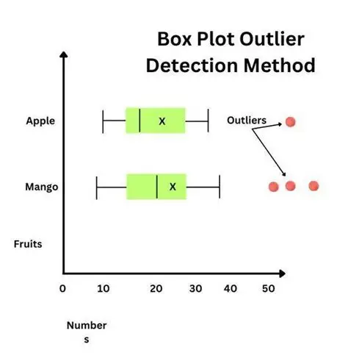
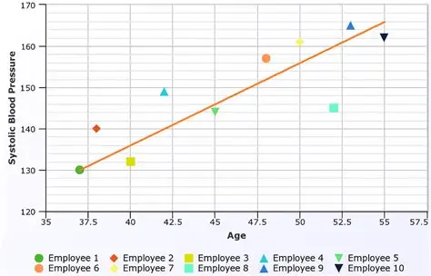
Outlier Detection
Methods: Boxplots, IQR, Z‑score
Findings:
Extreme revenue values
High employee counts in MNCs
Large customer bases in Retail
Bivariate Analysis
Numerical vs Numerical: Pearson correlation
Revenue ↔ Employee Count (Strong)
Revenue ↔ Customer Count (Strong)
Numerical vs Categorical:
Tech → highest revenue
Healthcare → stable margins

Slide 11
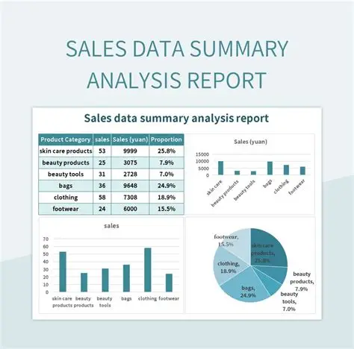
Conclusion
Applied: Univariate, Bivariate, Multivariate, Correlation, Outlier Detection, Skewness & Kurtosis
Provided insights for:
Business Intelligence
Market Trend Analysis
Revenue Forecasting
Strategic Decision Making

Slide 12

Libraries Used
NumPy – Numerical operations
Pandas – Data manipulation
Matplotlib – Visualization
Seaborn – Statistical plots & heatmaps

Slide 13


